Slide 1


IMOS AMSA 2025 Workshop
Working with GIS

Slide 2
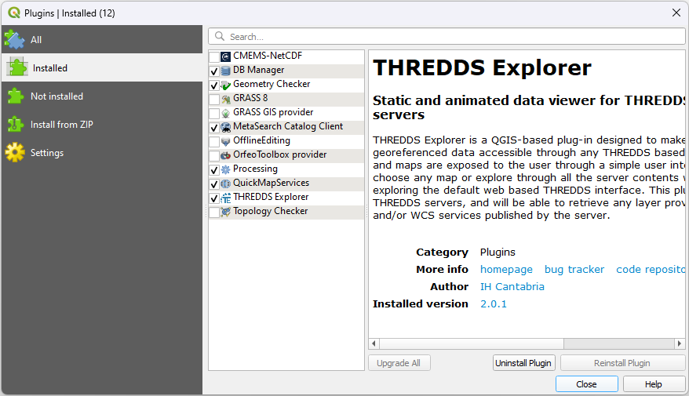
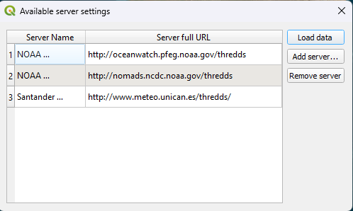
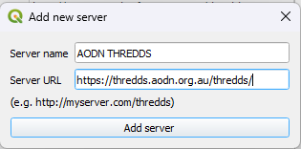
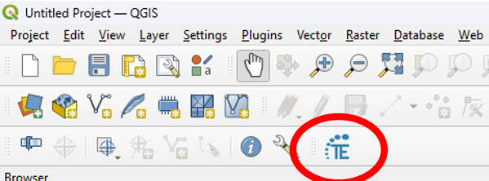
Discover Data
Easiest way to discover data that you might want to download and process is using the “THREDDS Explorer” plugin in QGIS. Instructions can be found in the GIT repository of the plugin.

Slide 3
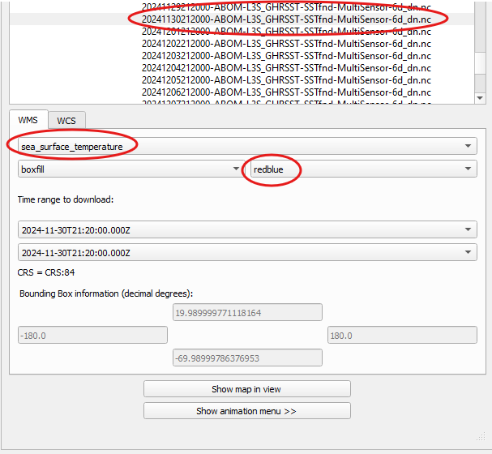
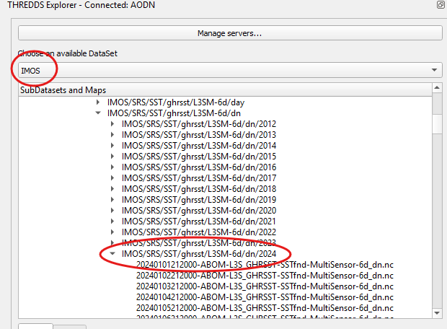
Data Discovery
Let's assume we would like to observe on the heatwave towards the end of 2024. We can navigate to the SRS product in TE. Navigate to IMOS/SRS/SST/ghrsst/L3M-6d/dn/2024 And find a date you would like to observe.

Slide 4
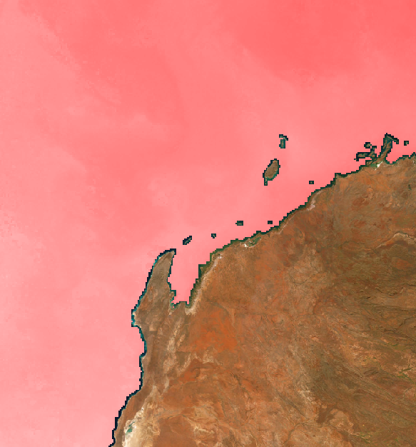
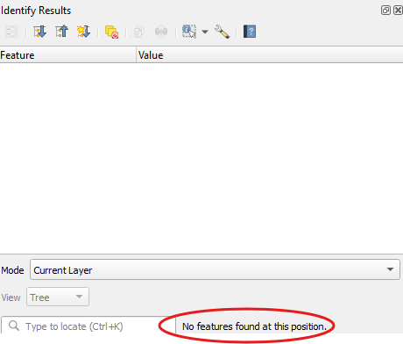
Visualisation Only
THREDDS Explorer does not import the actual data behind the file.
Allows to explore available data quickly.
Has some good features.

Slide 5
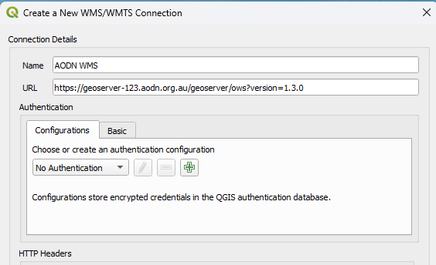
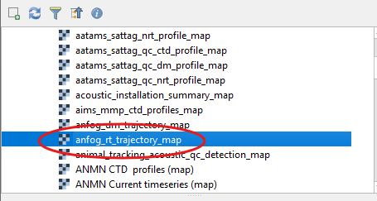
Other tools
Other tools include direct connection to WMS and WFS services Connect to WMS with the URL: https://geoserver-123.aodn.org.au/geoserver/ows?version=1.3.0

Slide 6
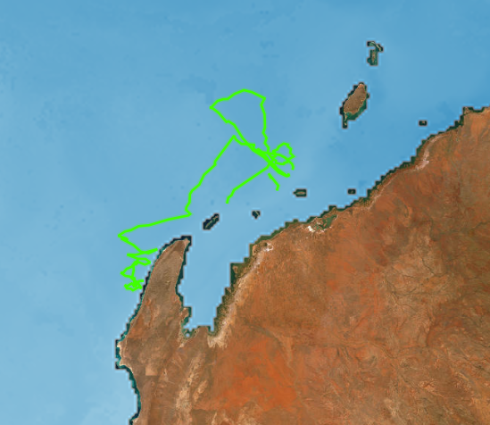
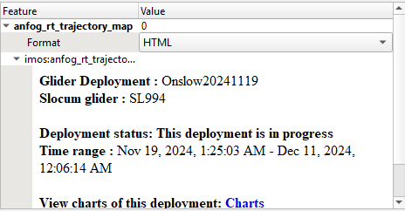
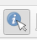
AODN WMS
The Web Mapping Service (WMS) provides track data Allows to identify time the tracks were made

Slide 7
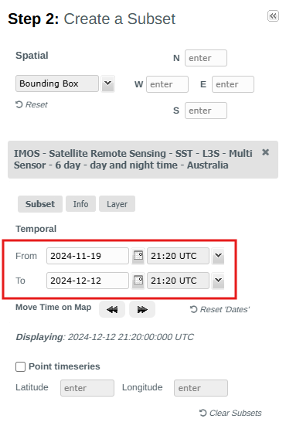
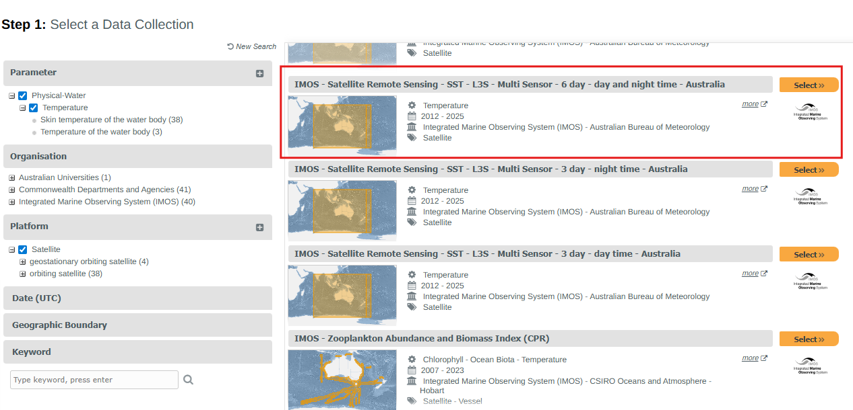
Download SST data
We can head to the portal to download the data we will be using today as an example. First the SST in the data range 19/11/24 – 12/12/24 Download the NetCDF file.

Slide 8
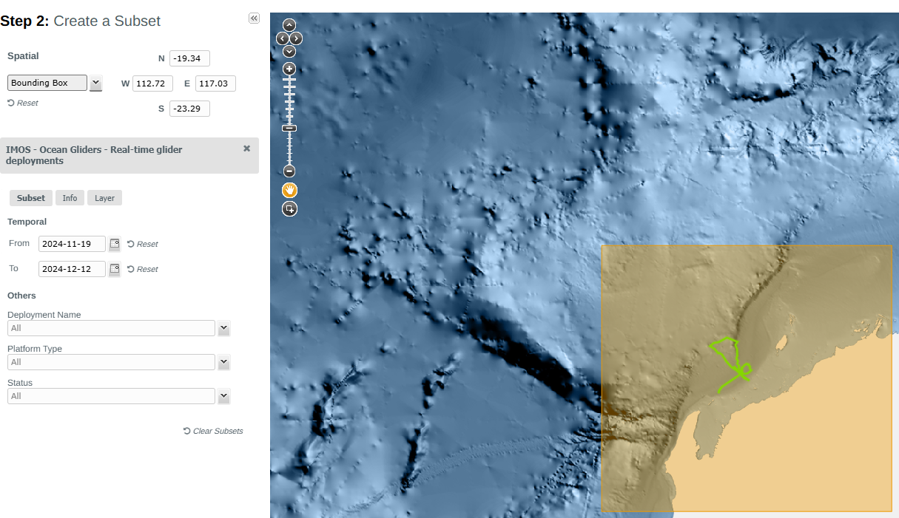
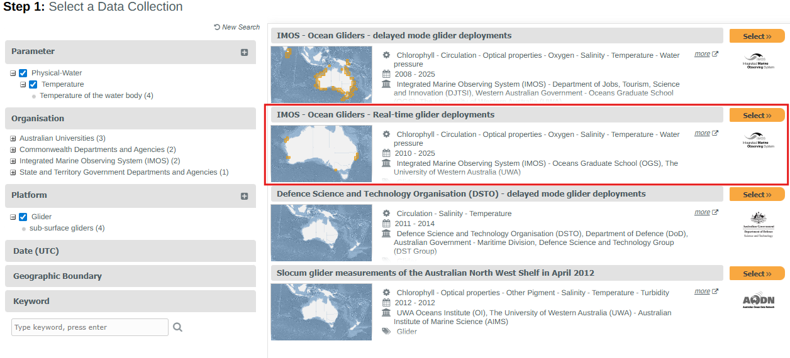
Download Glider data
Next download the glider track 19/11/24 – 12/12/24 and the bounding box around WA. Download the CSV.

Slide 9
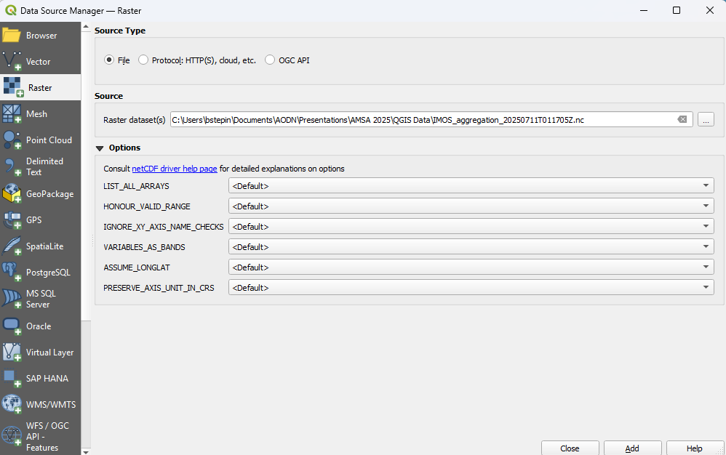
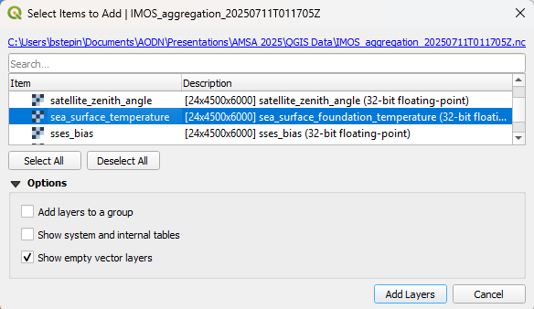
Load in the NetCDF file to the project

Slide 10
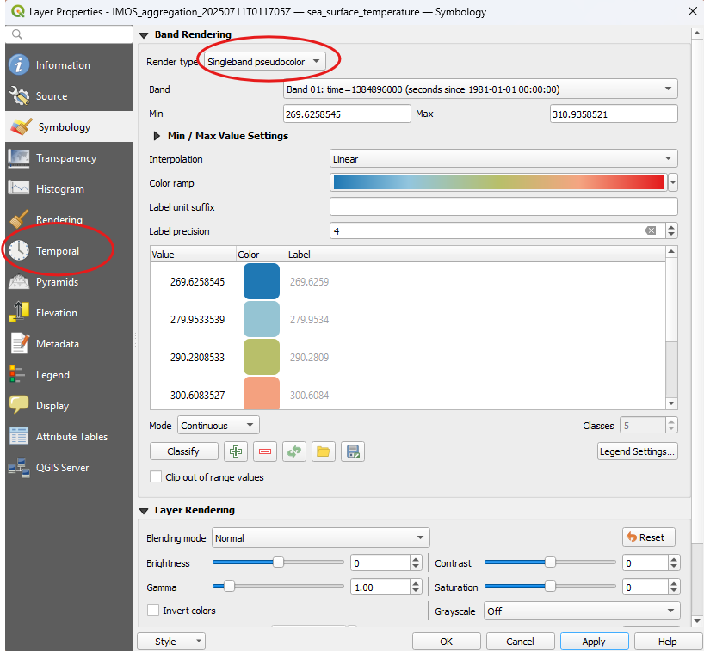
Refining the import
Imports multiband NetCDF Each band represents a day Set symbology to Single Band Pseudocolor Adjust colour Head to temporal tab

Slide 11
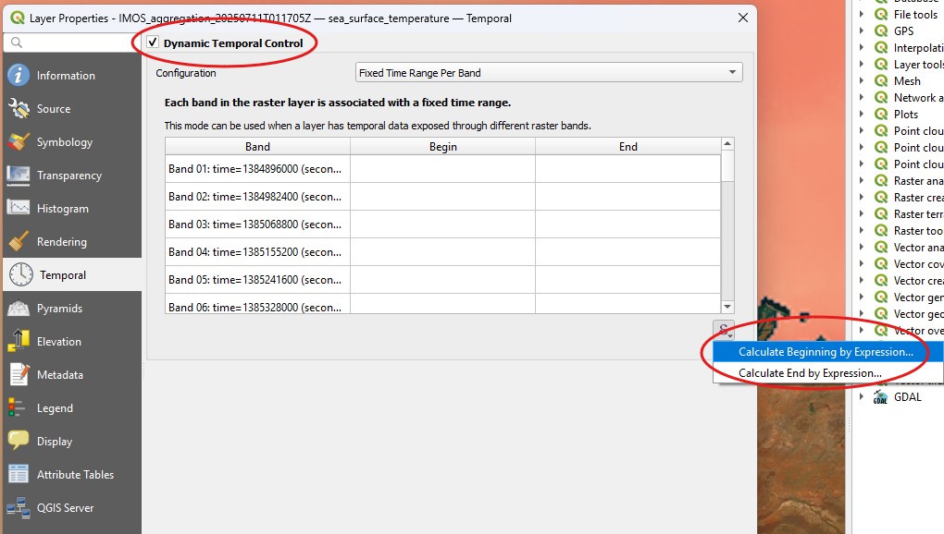
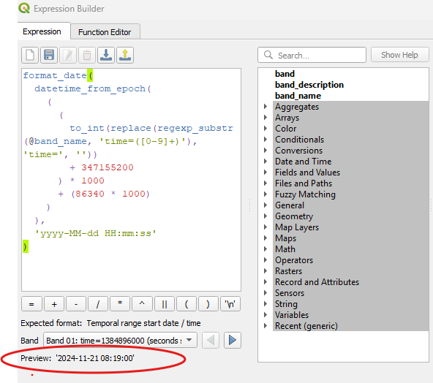
Heading
Head to the Expression calculator and enter the formula across. This Extracts the date from the band title, and formats it to the correct date/time format (seconds since 1/1/2021 0:00)
format_date(
datetime_from_epoch(
(
to_int(replace(regexp_substr(@band_name, 'time=([0-9]+)'), 'time=', ''))
+ 347155200
) * 1000
),
'yyyy-MM-dd HH:mm:ss'
)

Slide 12
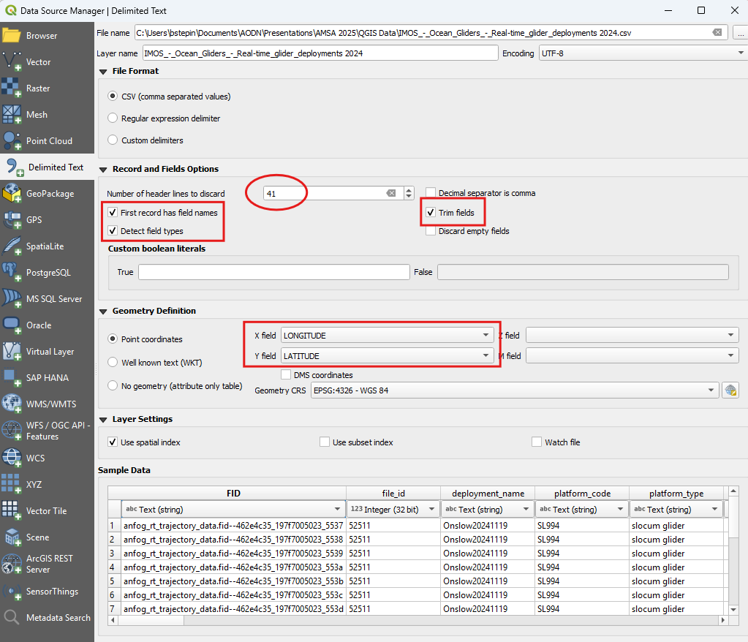
Add Glider data
Add “Delimited Text” Set the number of Header lines to 41, as the rest is embedded metadata. Ensure “Trim Fields”, “First record has headers” and “Detect field types” are enabled Ensure X and Y field are correctly assigned

Slide 13
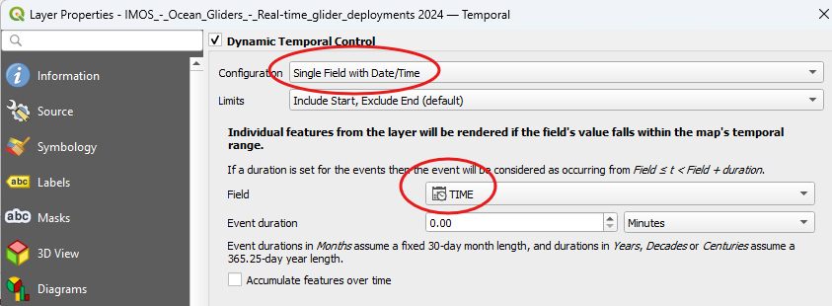
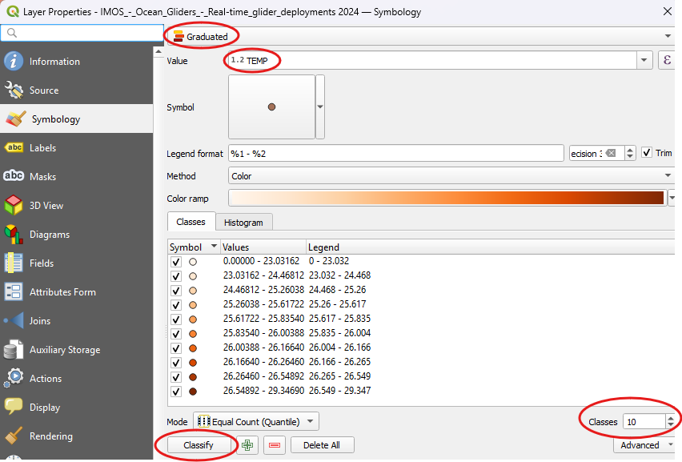
Adjust Data
Once added, go to layer properties and head to the Temporal tab Set single field with Date/Time and select “TIME” as the Field Go to the Symbology Tab and set to “Graduated”, Set value to “TEMP”, choose a colour ramp and then Hit “Classify”. (Using 10 in example)

Slide 14
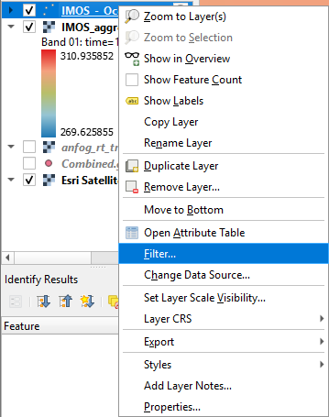
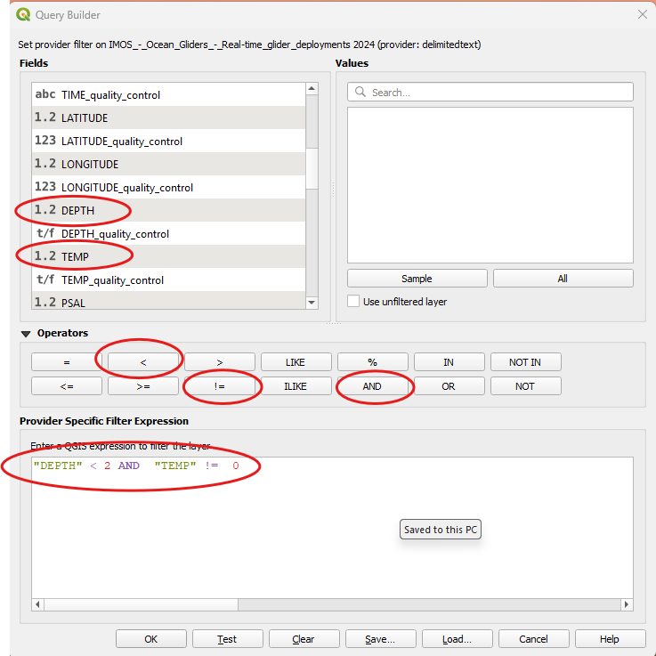
Filter to Surface Data
In order to compare only surface data we can filter to only observe the measurements the glider has undertaken at the surface. In this case we are assuming surface to be anything less than 2m depth We’re also not interested in values where the TEMP is set to 0 so use and “AND” operator.

Slide 15
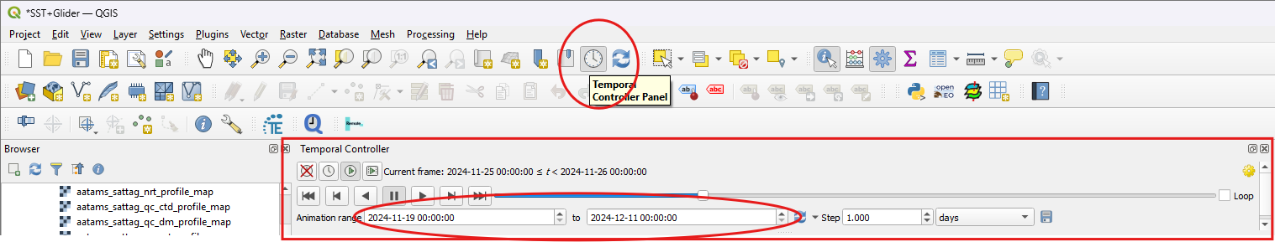
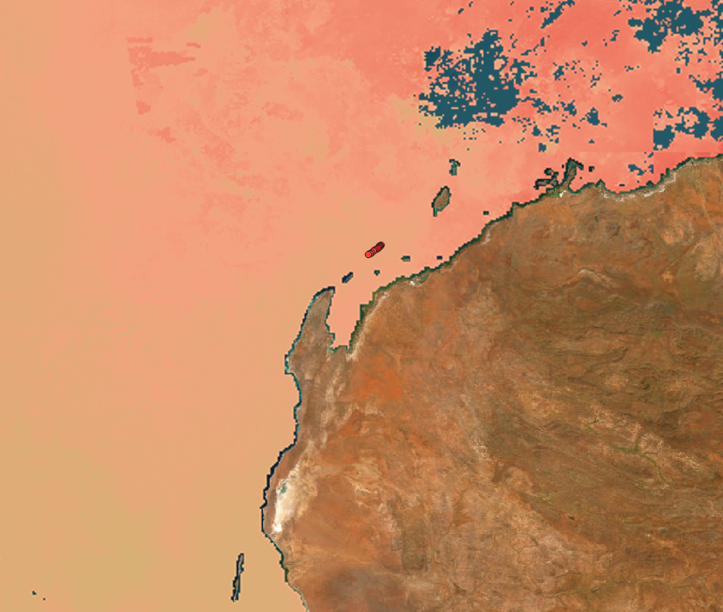
Activate the Temporal Controller
Open the Temporal Controller, set to the required date range and the increment to 1day. Now you can cycle through the glider days as well as the SST on that day and observe the changes.

Slide 16
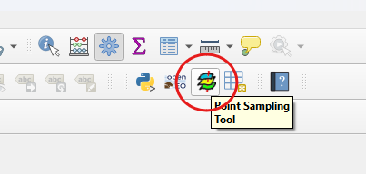
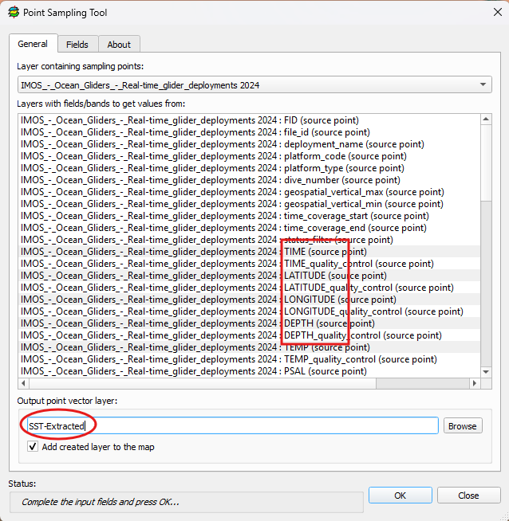
Extract the SST Values
If you’ve installed the “Point Sampling Tool” navigate to it to extract the points. From the Gliders select the values we would like to keep, noting the “Filtered” will not be extracted. In this example we are keeping “TIME” Lat/Lon, “DEPTH” and “TEMP” From the SST we are using the middle static band12. You can extract all the bands and then create an expression later in a similar fashion to the temporal expression we used earlier to extract the SST band corresponding to the date.

Slide 17
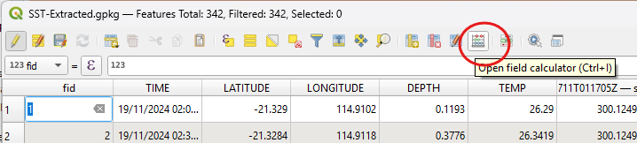
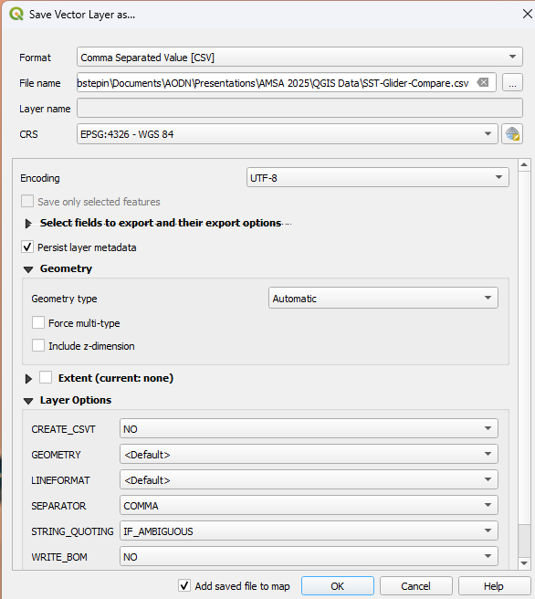
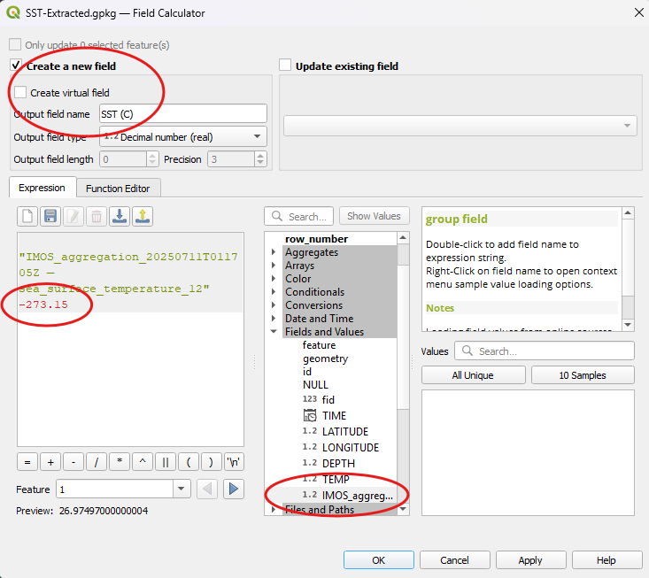
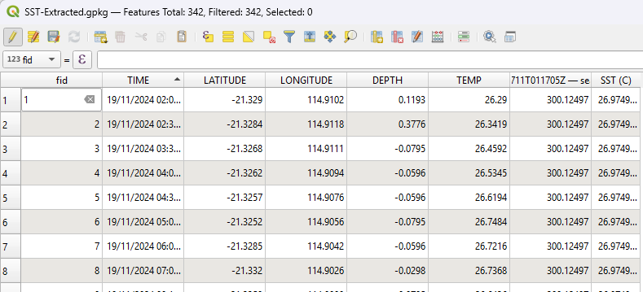
Correct from Kelvin to Celsius
Open the newly created layer “Attribute table” Open the Field Calculator, and create a new field Select the SST field and subtract 273.15 to convert to C. Name the column appropriately. Now this can be exported to CSV

Slide 18


